Slide 2
What are Minimal API
var builder = WebApplication.CreateBuilder(args);
var app = builder.Build();
app.MapGet("/", () => "Hello World!");
app.Run();
No API is ever that simple!

Slide 3




Minimal API marries DDD
Alberto Acerbis
alberto.acerbis@intre.it

Slide 4
I have already seen this code
var express = require('express');
var app = express();
app.get('/', function(req, res) {
res.send('hello world');
});

Slide 5

Minimal vs MVC
How deep is the rabbit hole?

Slide 6
Minimal != Simple
No support for content negotation. Just JSON
No native support for API versioning
No support for validation
But we have FluentValidation
No enforcement about project structure
and that is good!

Slide 7
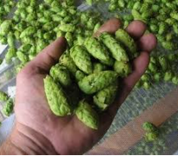

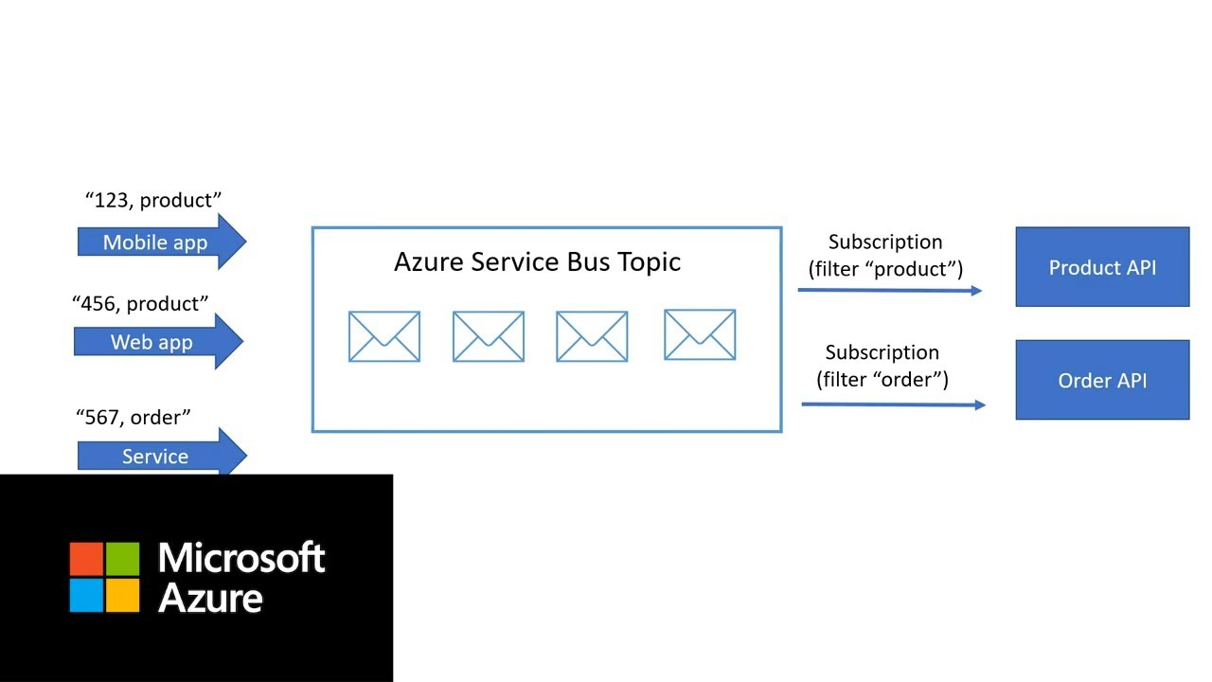

We Like to Brew Beer
Suppliers
Production
Pubs

Slide 8

Talk is Cheap … Show me the code
@Linus Torvalds

Slide 9
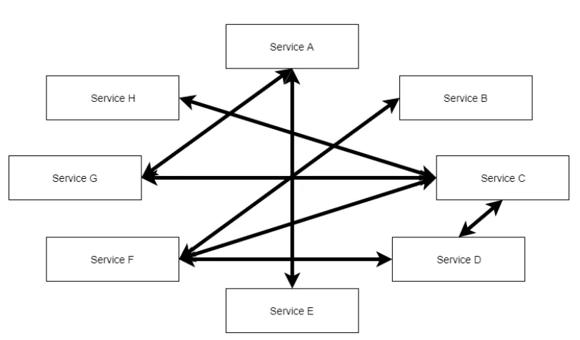
The Big Ball of Mud
The problem is not «The Big Ball» … the problem is «Mud»

Slide 10
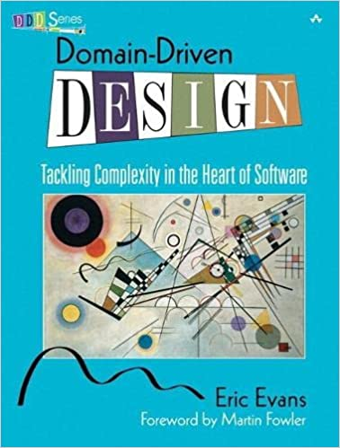
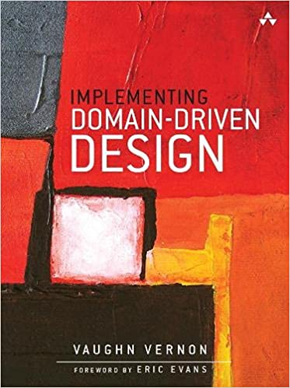
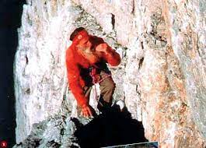
DDD – The Silver Bullet?
Tackling complexity in the heart of software
E.Evans – V.Vernon
Cercare il facile nel difficile
Bruno Detassis

Slide 11
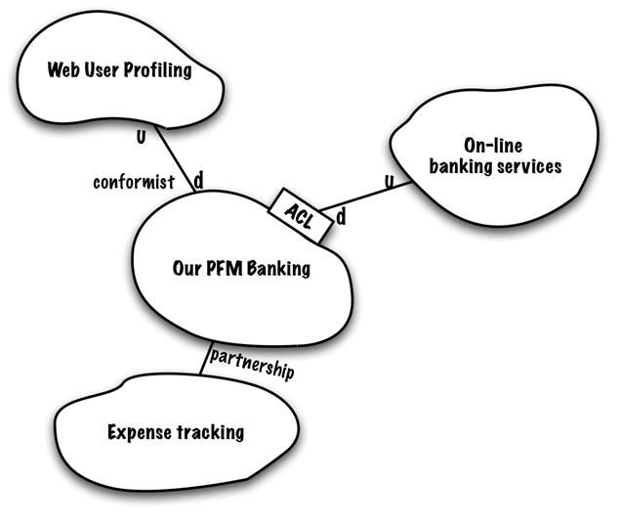
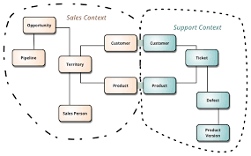
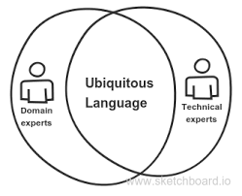
DDD – Strategic Patterns
Context Mapping
Bounded Context
Ubiquitous Language
https://www.infoq.com/articles/ddd-contextmapping/
https://martinfowler.com/bliki/BoundedContext.html
https://blog.carbonfive.com/ubiquitous-language-the-joy-of-naming/

Slide 12
Talk is Cheap … Show me the code
@Linus Torvalds

Slide 13
Microservices … What?

Slide 14
Microservice & Bounded Context
Feature | Bouded Context | Microservice | Compatibility
Organized around Business Capabilities | È implicitamente inteso nel concetto stesso di Ubiquitous Language, che è il pattern principale per identificare un Bounded Context | Teams Cross-Funzionali specifici per una funzionalità di business | Perfetta!
Decentralized Governance | Un modello condiviso per ogni scopo | Vengono favorite/incentivate le scelte locali, che devono essere indipendenti. | Perfetta!
Decentralized Data Management | La persistenza privata è fondamentale per la consistenza del linguaggio, ma soprattutto necessaria per l’evoluzione sicura e indipendente del modello | Ogni microservizio deve persistere i propri dati in un database privato! Pena l’impossibilità di evolvere autonomamente dagli altri | Perfetta!
Evolutionary Design | Ogni modello può, e deve, evolvere indipendente dagli altri | E’ una key feature | Perfetta!
Smart endpoints and dumb pipes | Raccomandato come modello strategico | Key feature. SOA docet! | Fattibile
Language Consistency | Ubiquitous Language! Obbligatorio! | Implicito e raccomandato | Nessun problema
Componentization via Services | Context Map | Key feature | Nessun problema
Products not Projects | Raccomandato per la conoscenza approfondita del modello | Key feature | Nessun problema
Design for Failure | DDD incentiva l’evoluzione continua | Key feature | Nessun problema

Slide 15
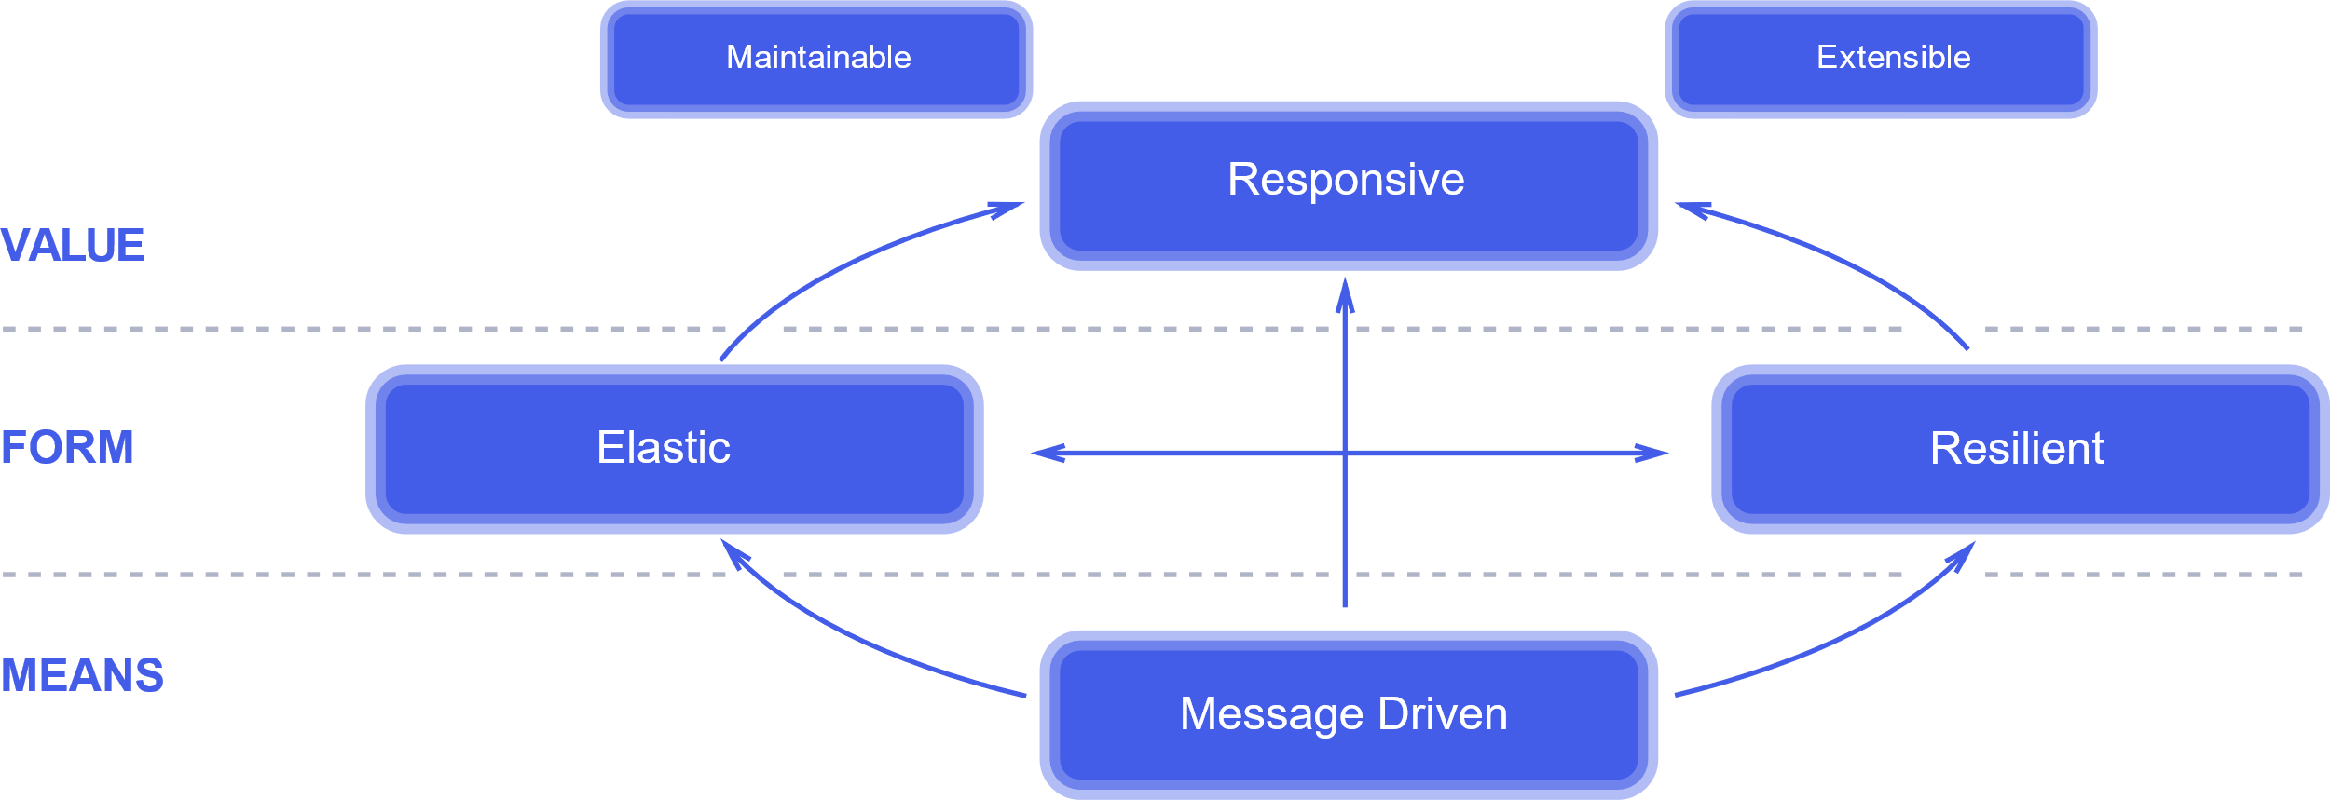
The Reactive Manifesto
Jones Boner, Dave Farley, Roland Kuhn, Martin Thompson – 16.01.2014
The absolute, most important thing is it to be responsive. This means that a reactive system needs to remain responsive event when a failure occurs.

Slide 16
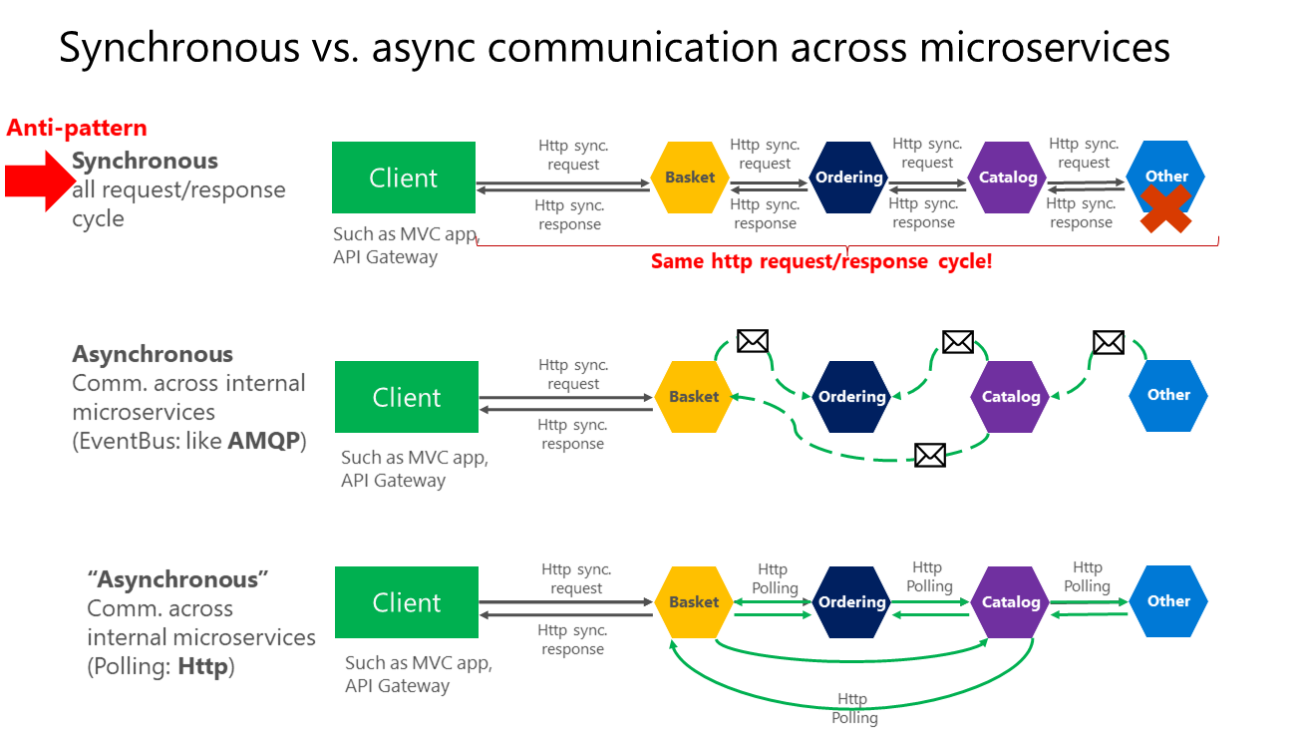
Communication in a microservice architecture
https://docs.microsoft.com/en-us/dotnet/architecture/microservices/architect-microservice-container-applications/communication-in-microservice-architecture

Slide 17
Talk is Cheap … Show me the code
@Linus Torvalds

Slide 19
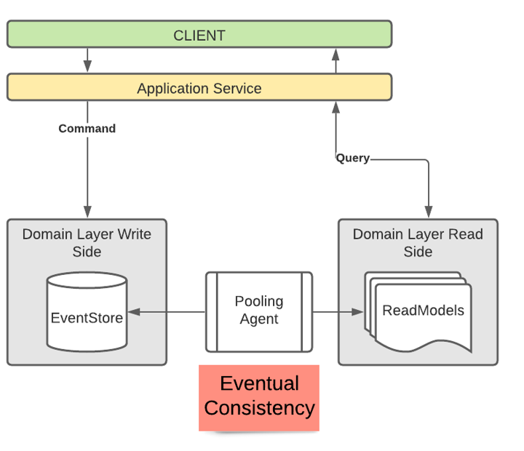
CQRS – Eventual Consistency
@Linus Torvalds

Slide 20



Minimal API marries DDD
alberto.acerbis@intre.it
@aacerbis
LinkedIn
https://github.com/brewup
https://github.com/Ace68/GlobalAzure2022
https://github.com/cqrs-muflone

